Slide 1
2022-2023
Spring Sports Information Meeting

Slide 2
Important
Information
Spring Sports Meeting Agenda
Who We Are
Athletic Training Services & Policies
Registration & Preseason Requirements
ParentSquare & Communication Policy
NHIAA / Athletic Department Policies
Sportsmanship: Players & Fans Expectations
Staying Connected & Up-to-Date
Important Dates

Slide 3
Raymond HS
Athletics Team
Josh Forkey
Travis Glennon
Track & Field Head Coach
votrack@sau33.com
RHS Athletic Director
rhsad@sau33.com
Ed Trafton
RHS Athletic Director
votrack@sau33.com
Heather Fanning
Mike Brazeau
RHS Athletic Trainer, ATC
h.fanning@sau33.com
RHS Athletic Director
vbaseball@sau33.com
Ben Byerly
RHS Athletic Director
vsoftball@sau33.com
Sharon Wilson
Bill Hayes
RHS Principal
s.wilson@sau33.com
RHS Athletic Director
utrack@sau33.com

Slide 4
Athletic Training Department
Raymond High School
Athletic Trainer: Heather Fanning
Athletic Trainer for 11 Years
Primarily working in Colleges and HS
Contracted to Raymond High School through Exeter Hospital
Team Physician: Dr. Joseph Bernard, DO, Concussion Specialist, Core Orthopedics and Sports Medicine

Slide 5
What Is an Athletic Trainer?
A high-qualified, multi-skilled healthcare professionals who render services in accordance with their education and training related to primary care, injury and illness prevention, wellness promotion and education, emergent care, examination and clinical diagnosis, therapeutic intervention and rehabilitation of injuries and medical conditions
Athletic trainers can work in a variety of settings, from education to military to performing arts to hospitals and clinics

Slide 6
What is My Role as AT?
Help to prevent and manage any neuromusculoskeletal injuries sustained by student-athletes
This can be any injury from an ACL to ankle sprain to concussion to spinal injury
Figure out what the injury/illness is and how to treat it
Here to keep your children safe and healthy while they participate in sports

Slide 7
Injury Policy
Athletes and Coaches must report all injuries no matter how minor to the athletic trainer
Often times I can save you a trip to the doctor’s by figuring out what’s wrong and being able to treat it myself
Injury outcomes often improve with active treatment and rehabilitation over just rest
If a referral seems necessary with our connection to Exeter athletes can often be seen quickly by high quality providers
If your child is treated by a outside medical provider (i.e. MD, DO, PA or NP) then a note must be provided to athletic trainer after initial evaluation
A doctor’s/clearance note should be provided after every follow-up as well
Notes should include the following: clinical diagnosis, statement of return to play/sports, any restrictions upon return and date of return
Once the note from outside provider is received the student-athlete will have to come check-in with me for clearance to participate in RHS athletics
If return seems questionable/disagreeable from the outside provider’s opinion the parents will be notified

Slide 8
Concussion Policy
Concussions otherwise known as a Mild Traumatic Brain Injury is caused by a bump, blow or jolt to the head or a hit to the body that causes the head and brain to move rapidly back and forth
If an athlete is suspected of having a concussion they will be immediately removed from play for the remainder of the day
Parents/Guardians will be notified and athlete will be required to be evaluated by doctor
Can be PCP/Pediatrician or Specialist
School Nurse will be notified for academic accommodations

Slide 9
Concussion Policy II
Athlete will need to be symptom-free for at least 24 hours and must provide clearance from their doctor and the Return to Activity Post Head Injury Consent form
The athlete will need to come see me for clearance and take the ImPACT test in order to start return to play
Return to Play is a 5 step progression back into activity
Step 1: 20-30 minutes light aerobic activity
Step 2: 30-45 minutes moderate aerobic activity
Step 3: Sport-specific non-contact activity
Step 4: Full practice
Step 5: Return to competition
Athletes must be symptom free through each step in order to move forward, if symptomatic activity will stop and they can repeat the step the following day if symptom-free
A concussion information sheet will be provided before the start of the spring season that has a lot of important information like signs and symptoms and RTP info

Slide 10
Pre-Existing Conditions
If your child has any heart issues or has had any heart issues in the past please make sure this information is disclosed on their physical or disclosed directly to me
Please make sure the clinical diagnosis is clearly stated as well as any procedures related to the diagnosis
Other examples of pre-existing conditions that should be being disclosed are conditions such as Type 1 Diabetes, Anaphylaxis allergies (especially bees w/outdoor sports), Sickle Cell Trait Autoimmune Disorders, and missing organs (i.e. only one kidney)
Anything that could be exacerbated by physical activity and could result in a dangerous situation for your child and can be managed more appropriately if not avoided if I am aware of what’s going on

Slide 11
Safe Space
The athletic training room is a safe space for all student-athletes
All athletes are welcome in that space at anytime
If you are uncomfortable coming to the training room for whatever reason we can make alternative arrangements

Slide 12
Contact Info
Heather Fanning ATC, NHLAT
Email:h.fanning@sau33.com
Office Phone:603-895-6616 ext. 2320

Slide 13
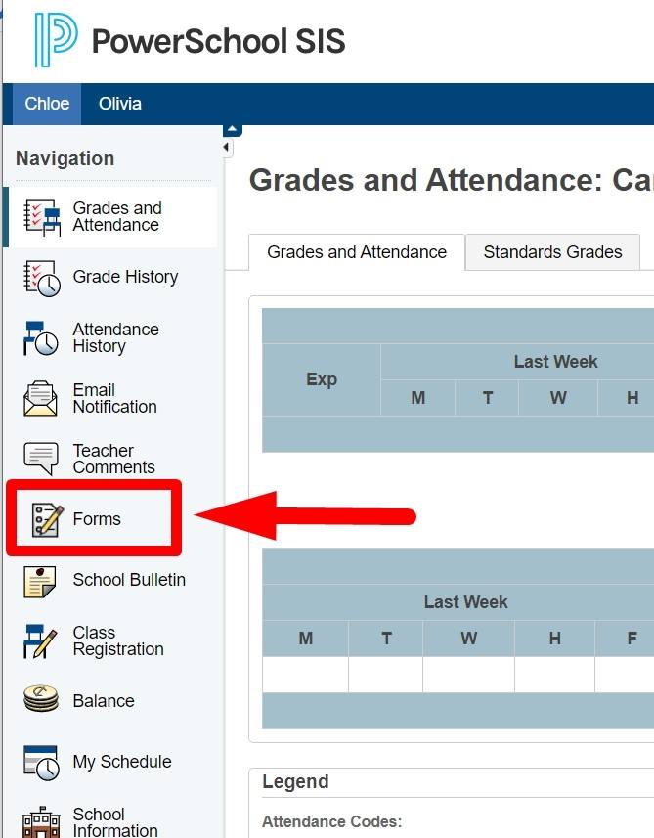
Spring Sports Registration
Spring sports registration and sign up have begun and continue until March 10th. Any student-athletes wanting to register and sign up for a spring sport after March 10th will need the approval of the Athletic Director (Mr. Glennon). Please note the following information regarding Spring Sports:
ALL REQUIRED SPRING SPORTS REGISTRATION PAPERWORK IS LOCATED UNDER THE FORMS SECTION OF POWERSCHOOL
Completed Health Emergency Form (Completed & Returned)
Participation Waiver (Signed Agreement)
Code of Conduct Form (Signed Agreement)
Physical (Update within the last 12 Months - N/A if submitted for Fall / Winter Seasons)
Student-Athlete Handbook (Signed Agreement)
Concussion Awareness (Completed & Returned)
Online School Registration (Completed & Returned)
ImPACT Testing (Scheduled via the RHS Athletics Department)

Slide 14
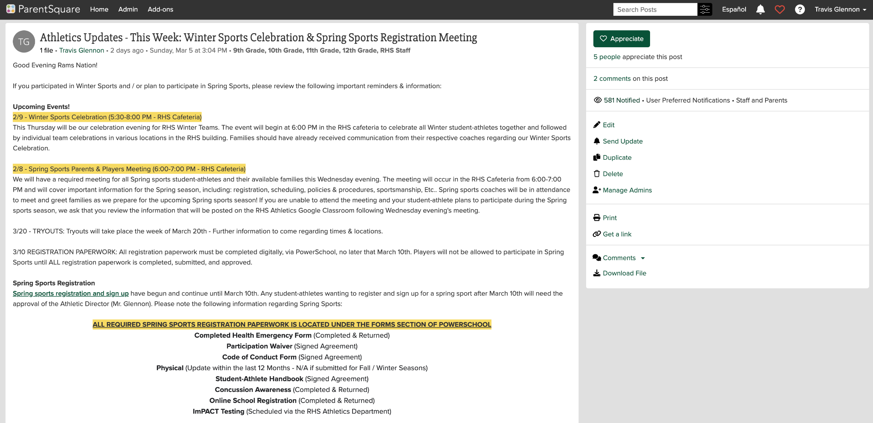
ParentSquare
SIGN UP FORM
Students must sign up for Spring Sports with their student SAU33 Google login

Slide 15
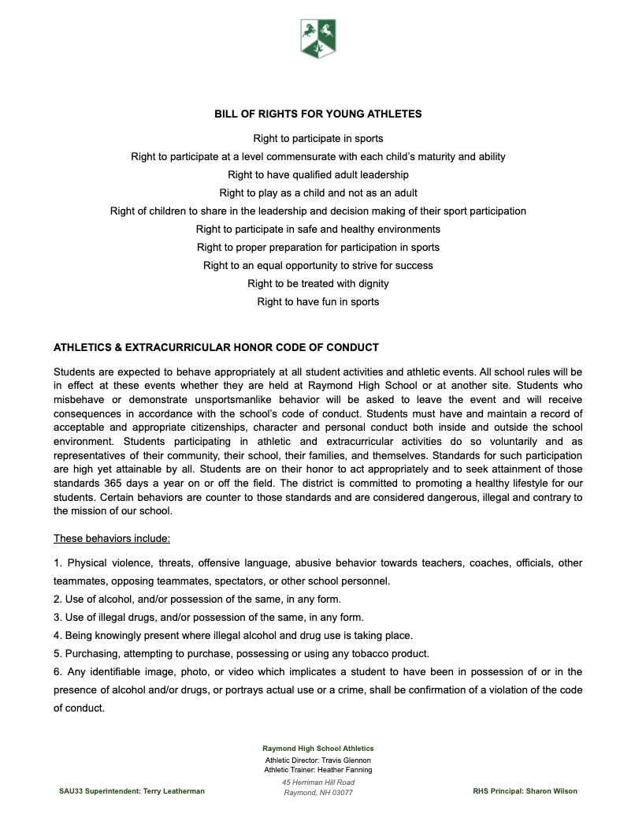
Athletics
Policies

Slide 16
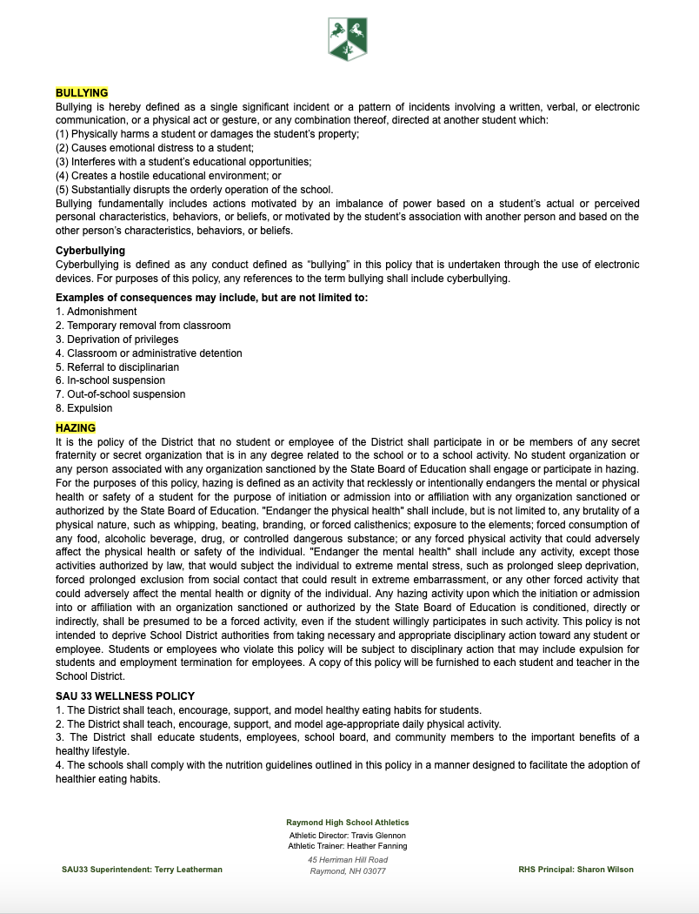
About us
Athletics Policies

Slide 17
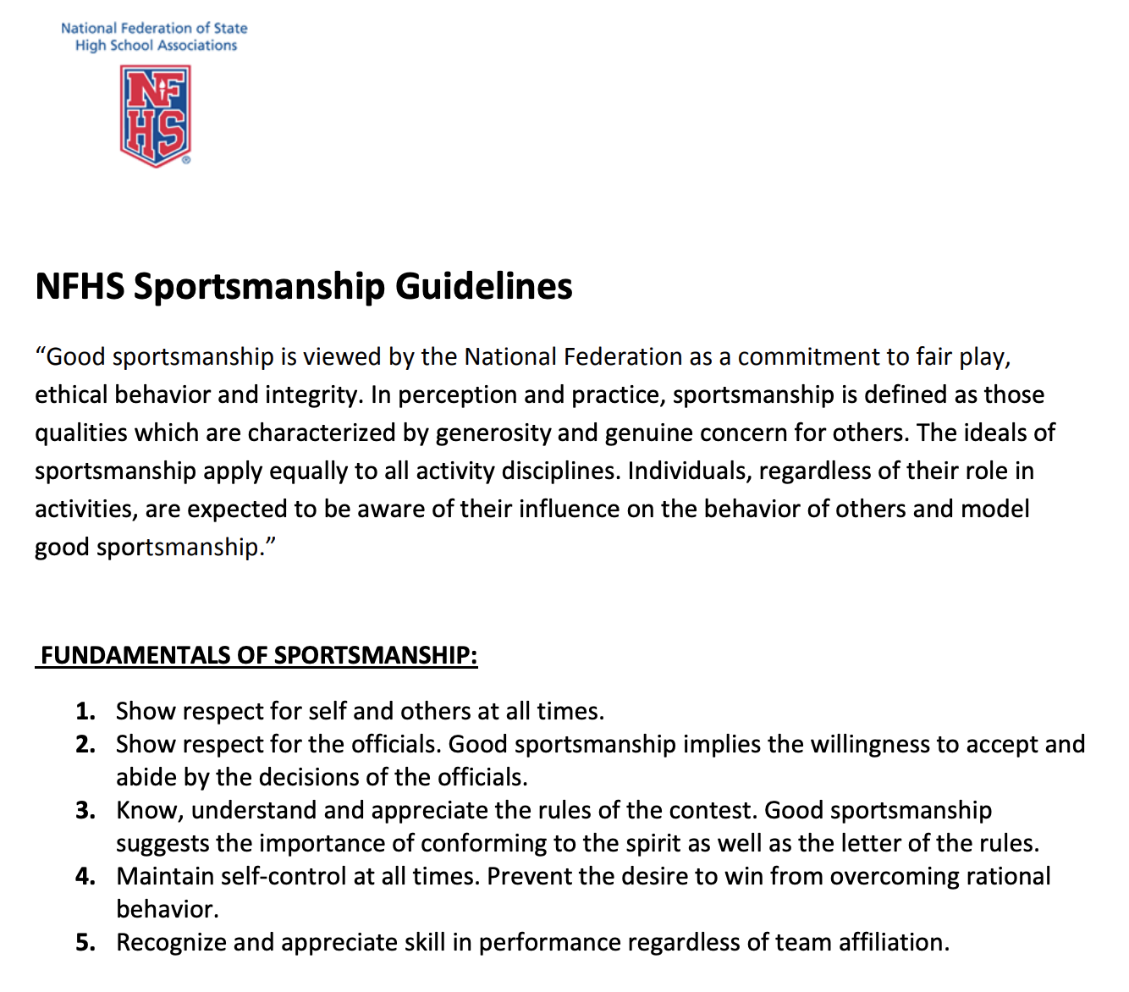
SPORTSMANSHIP
EMPHASIS
EMPHASIS
OFFICIALS:
The NHIAA & NFHS has put an emphasis on the fair treatment of officials & umpires - Players & Fans are to refrain from interacting with or directing comments towards officials & umpires.
OPPONENTS:
The NHIAA & NFHS has put an emphasis on the spirit of spectatorship - Coaches, Players, & Fans are to demonstrate positive appreciation for all contestants and are to focus spectatorship on their respective teams.

Slide 18
Student
Athlete
Support
Model
Player Experience
Administration
Student
Athletes
Coaches
Families
Player Development
Player Encouragement
Families

Slide 19
SCHEDULES | BigTeams

Slide 20
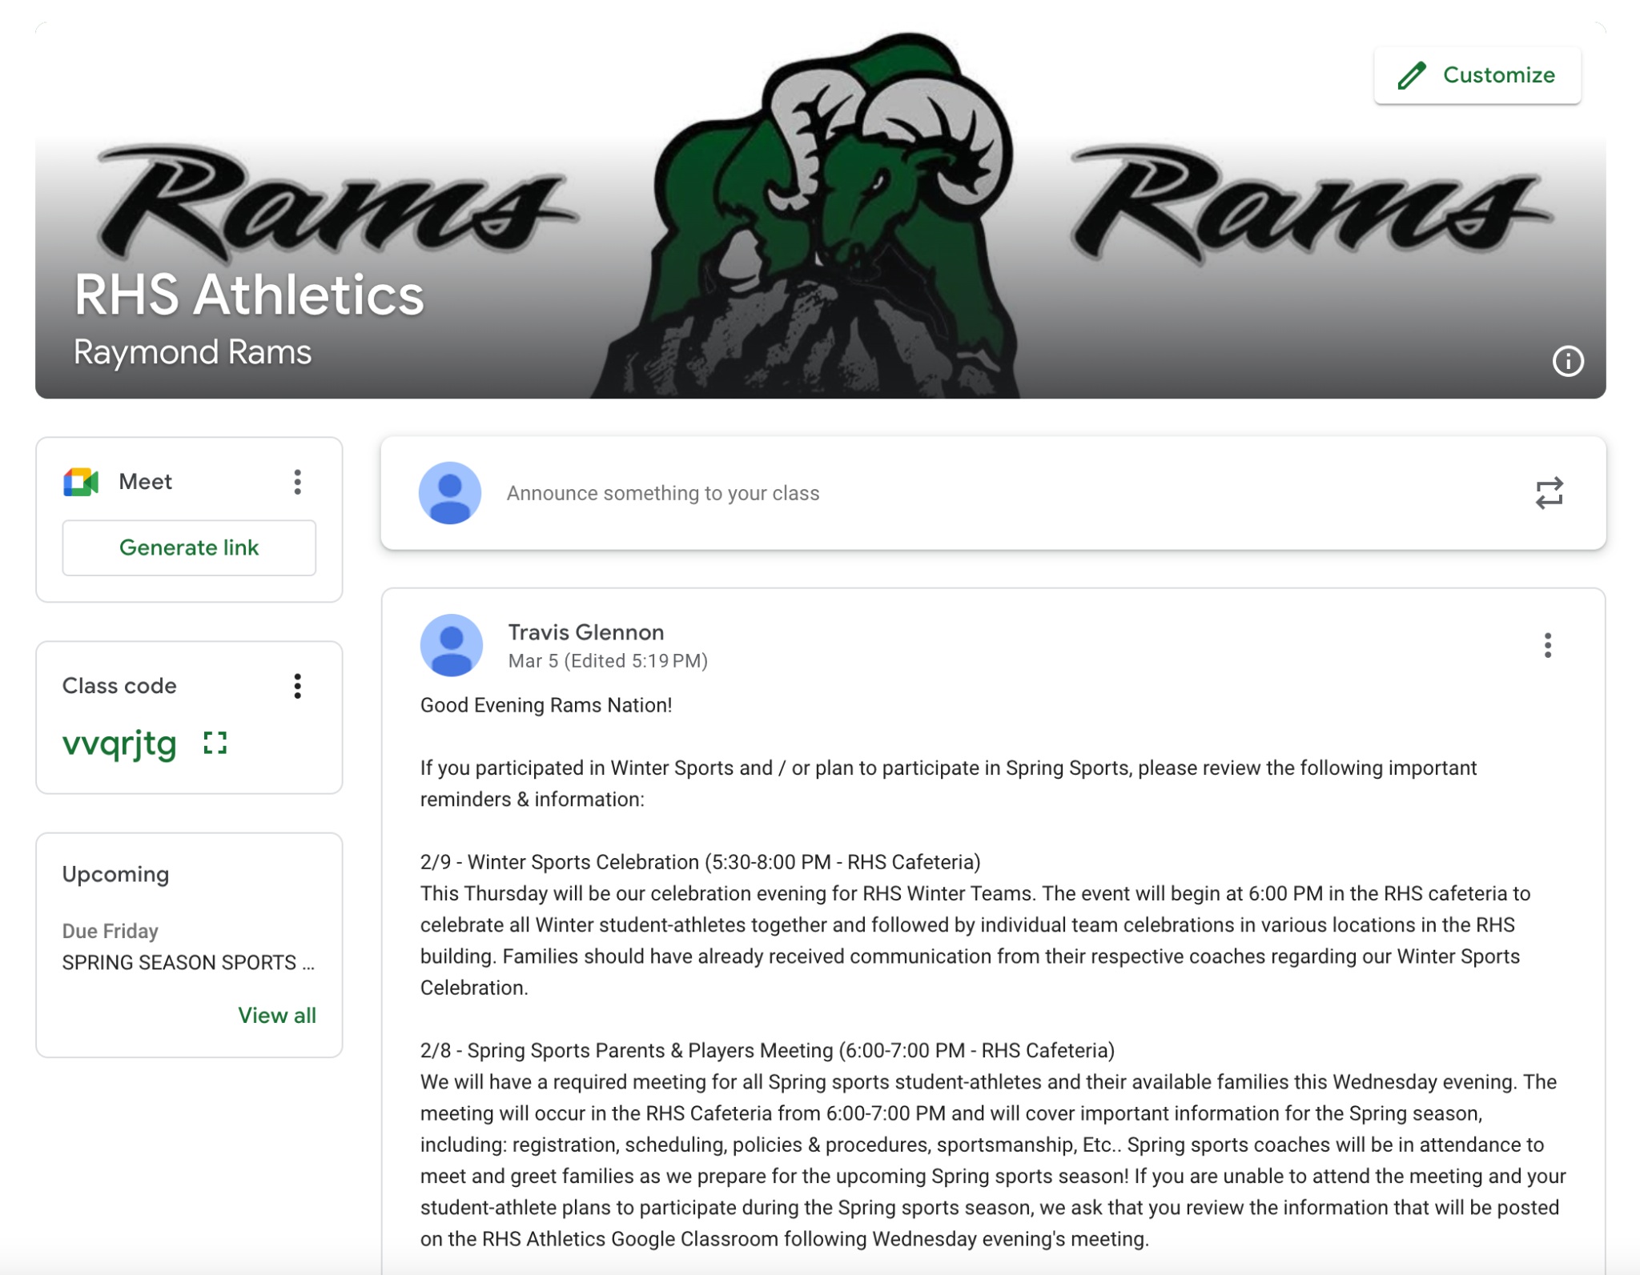
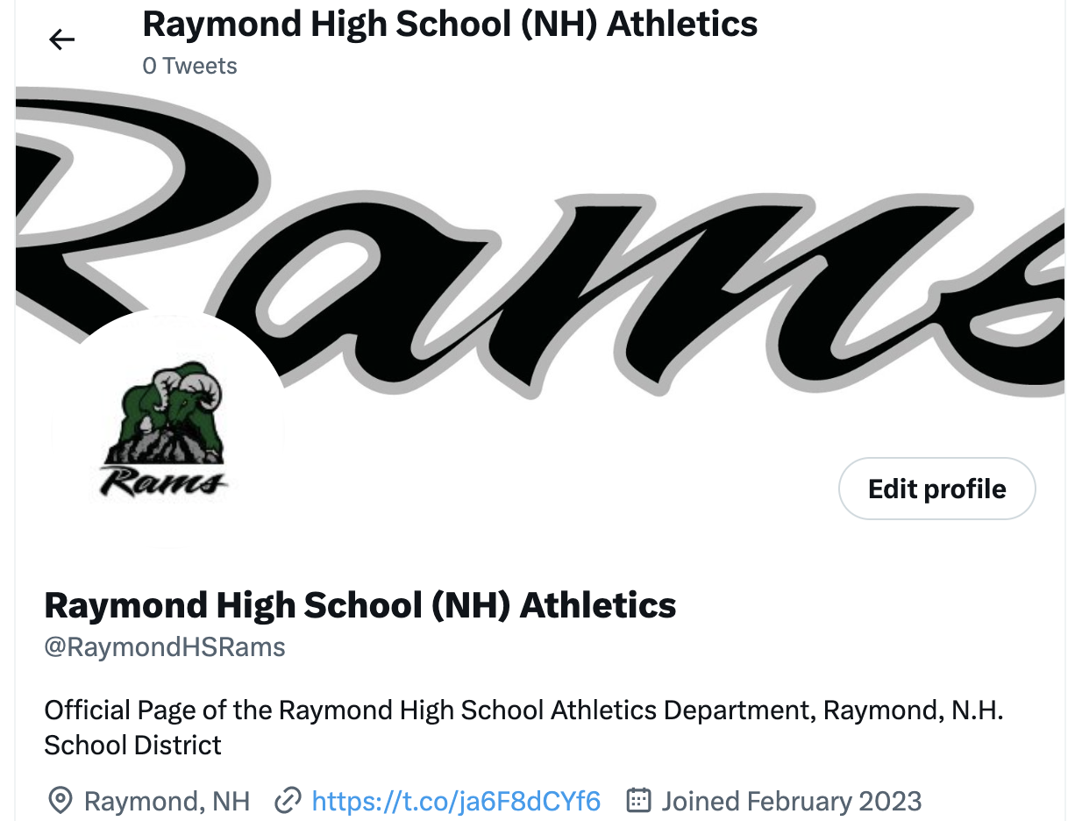
@RaymondHSRams
Class Code: vvqrjtg

Slide 21
SPRING
SEASON IMPORTANT
DATES
March
March 20th
NHIAA Spring Season Starts - RHS Tryouts
April
April 10th
NHIAA First Date of Competition
June
Week of June 1st
NHIAA Playoffs Begin
June
Week of June 12th
Spring Sports Celebration

Slide 22
THANK YOU!
Please take some time to review the previous slides for linked images leading to additional resources.

